Slide 1

GEETHANJALI COLLEGE OF ENGINEERING AND TECHNOLOGY Department of Electronics & Communication Engineering Project Report on AUTONOMOUS DRONE WITH LIVE VIDEO FEED USING GPS under the Guidance of Dr.Saladi Saritha Associate Professor BATCH NO-C09 N.MOULIKA - 17R15A0429 A.SAI RAHUL - 16R11A0499 R.BHASKAR - 17R15A0424

Slide 2
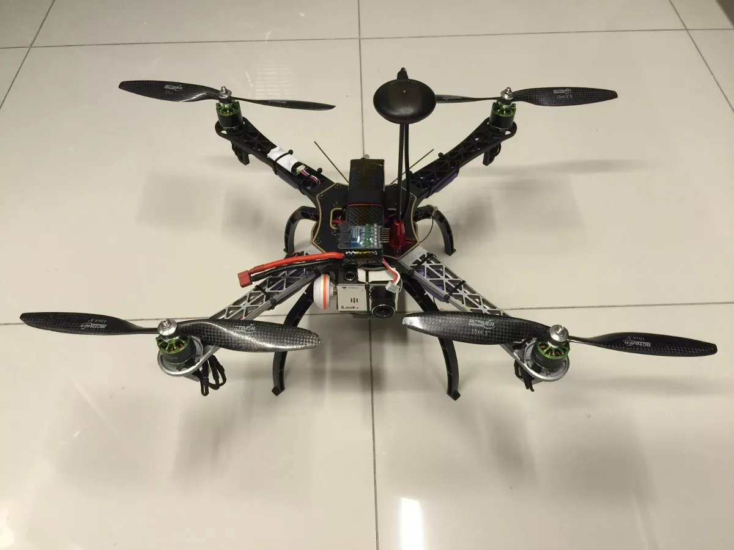
AUTONUMOS DRONE WITH LIVE VIDEO FEED using GPS
CONTENTS
Abstract
Hardware Required
Software Required
Principle of working
Applications
Conclusion

Slide 3
Abstract
A quadcopter can achieve vertical flight in a stable manner and be used to monitor or collect data in a specific region such as Loading a mass. Technological advances have reduced the cost and increase the performance of the low power microcontrollers that allowed the general public to develop their own quadcopter. The goal of this project is to build, modify, and improve an existing quadcopter kit to obtain stable flight, gather and store GPS data, and perform auto commands, such as auto-landing. The project used an Aero quad quadcopter kit that included a frame, motors, electronic speed controllers, Arduino Mega development board, and sensor boards and used with the provided Aero quad software. Batteries, a transmitter, a receiver, a GPS module, and a micro SD card adaptor were interfaced with the kit. The aero quad software was modified to properly interface the components with the quadcopter kit.
- Individual components were tested and verified to work properly. Calibration and tuning of the PID controller was done to obtain proper stabilization on each axis using custom PID test benches. Currently, the quadcopter can properly stabilize itself, determine its GPS location, and store and log data. Most of the goals in this project have been achieved, resulting in a stable and maneuverable quadcopter. KEYWORDS Drone/Quadcopter, Transmitter & Remote, Propellers, Electric Motors, Battery

Slide 4
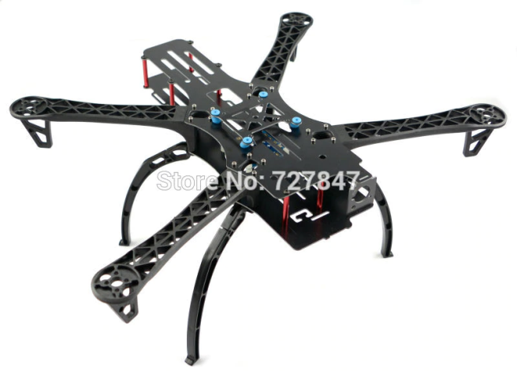
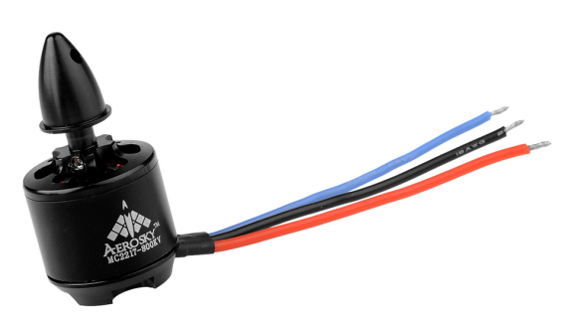
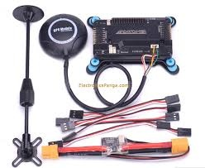
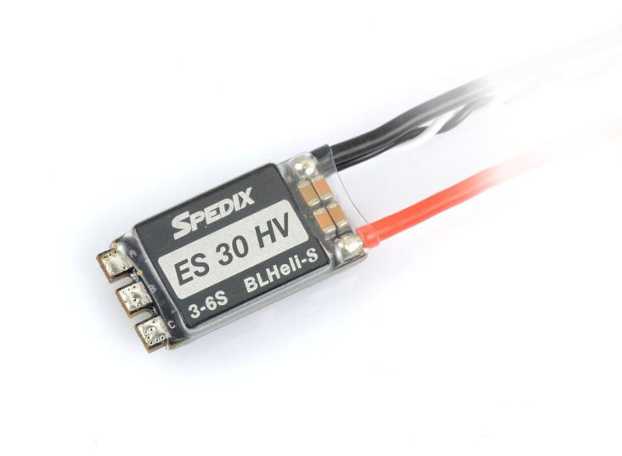
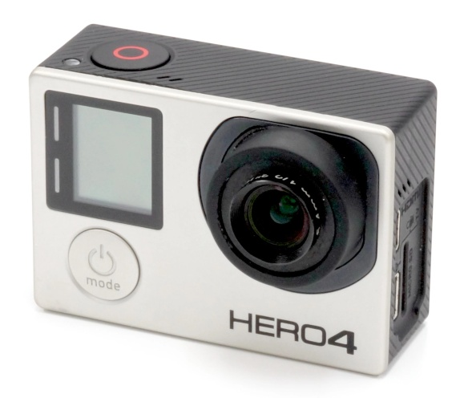
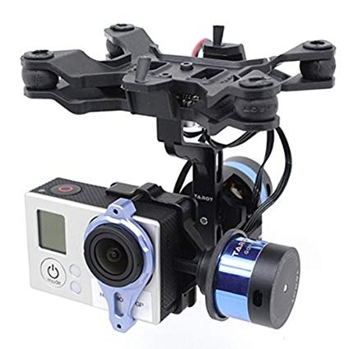
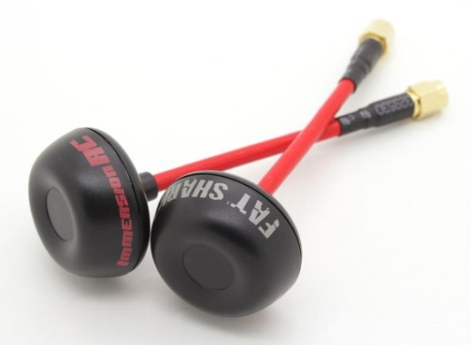
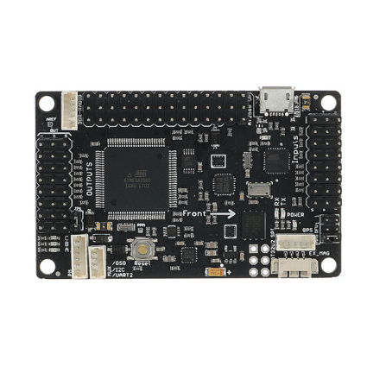
HARDWARE REQUIRED
Carbon fiber frame
Heavy lift motors
Esc (30a)
Apm 2.8 flight control board
Gps neo 8
2- axis Gimbal
Gopro camera
Video transmitter
Vr goggles
Circular polorised antenna
Etc
Radio transmitter and reciever

Slide 5
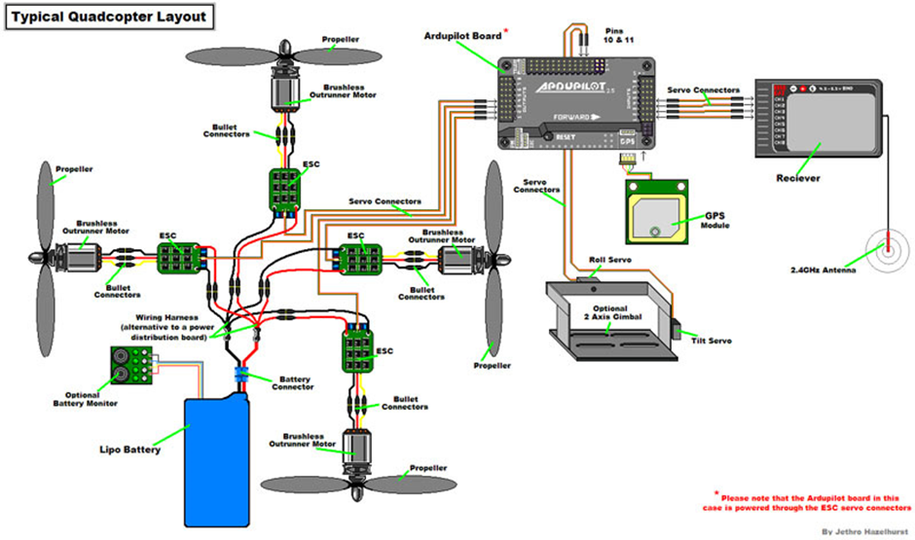

Slide 6
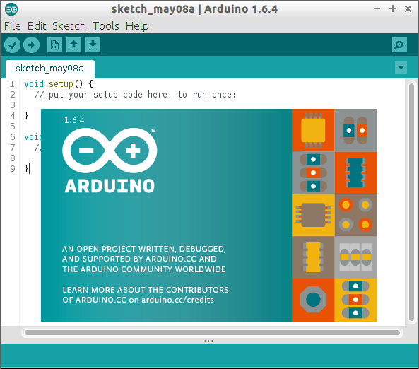
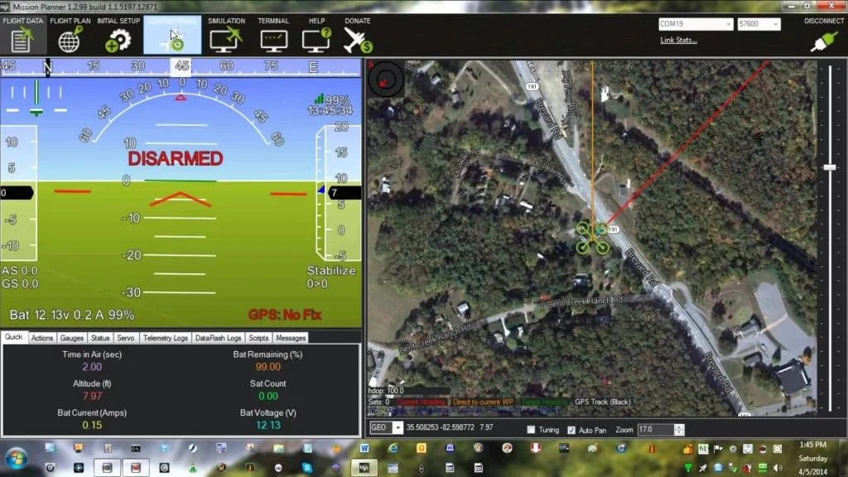
SOFTWARE REQUIRED
1.Mission planner
2.Arduino software

Slide 7
PRINCIPLE OF WORKING

Slide 8
WORKING OF DRONE
The drone uses ATMEL MEGA MICROCONTROLLER for it perform various functions
The motors are mounted in equal distance from each other in for of a X
The ESC which control the speed of the motors for it to maneuver the drone to our desired inputs
The GPS(Global Positioning System) is used in this drone for it perform automatic flying to desired waypoints and also take off and land on its own after loosing signal
This Setup can be understood by our subject embedded systems

Slide 9
Applications
Drone reconnaissance
its mainly used by the military to infiltrate the enemy and also see through the enemy lines
Disaster management
In the time of a natural or man made disaster we can use drones for search and rescue and also assess the severity of the situation
Land plotting
Surveillance live
It can be used as a surveillance drone because it can give the live video feed to the operator to understand the situation at that moment itself
Power line inspection
Dealing with powerlines is very dangerous, the height and the conductivity is a huge risk, hence its preferred to use drones. We can see the power lines clearly through the drones live video feed

Slide 10
CONCLUSION
A small drone can help us in many ways, making a tough job easy, making a job full of risk, safe. With the drone guidelines one can operate a drone safely and correctly to optimize its function and also in an event of crash the parts can be replaced making it modular and easy to handle. Hence drones can help us in the ways we haven’t imagined yet and the future of drones has just beginned.

Slide 11
THE END

